Slide 1
Student Leadership in Adult Education
While We Wait to Get Started…
Rename yourself <Your Name, Pronouns, Program Name>
Keep distractions to a minimum <close other tabs, put away phone>
When able, keep video on and audio muted
Turn on CC, if needed.
ADEI Community of Practice
Semester 2, Session 1
February 6, 2024

Slide 2
Welcome and Introductions
WOULD YOU RATHER…?
IAN BROWN
OR
JENNI GREENE
ELAINE FARBER BUDISH
GOOD SINGER
GOOD DANCER

Slide 3
Land, Labor, & Liberation Acknowledgement
The legacy of colonialism and slavery persists today as we continue to dismantle oppressive systems. We encourage you to research & acknowledge past harm, and support your current, local BIPOC communities in actionable ways.

Slide 4
Community Agreements

Slide 5
Looking Back to Move Forward
Core ADEI Learning Sessions & CoP
BUD =
An Opportunity
ROSE =
A Win
THORN=
A Challenge

Slide 6
Community Connections
What does Student Leadership in Adult Education
mean to you?
What are you hoping to get out of this CoP?

Slide 7
In this CoP, we will…
Session #1: February 6 Raise Awareness and Explore Opportunities for Action
A
Session #3: April 9
Plan a Process for Transformation as a Team accountable to shared values and goals
The A - C - T Framework
T
C
Session #2: March 12 Explore Changes in Mindsets and Practices Needed by Crucial Stakeholders

Slide 8
What skills does student leadership develop?
Interpersonal Communication
Written Communication
Oral Communication
ADEI Communication
Adaptability
Decision Making
Critical Thinking
Connection
Teamwork
Creativity
Problem Solving
Curiosity
Organization
Appreciation
Presentation
Compassion
Time Management
Project Management
Emotional Management
Courage

Slide 9
Impact of Student Leadership
“Making friends, having fun, developing myself, helping others and contributing values to my community.” – COABE Article: “I didn’t just want a degree”: Students’ perceptions about benefits from participation in student leadership programmes, January 2019
Table of Highest Impact Benefits

Slide 10
Know Your Students
Know the Opportunities
Raise Awareness

Slide 11
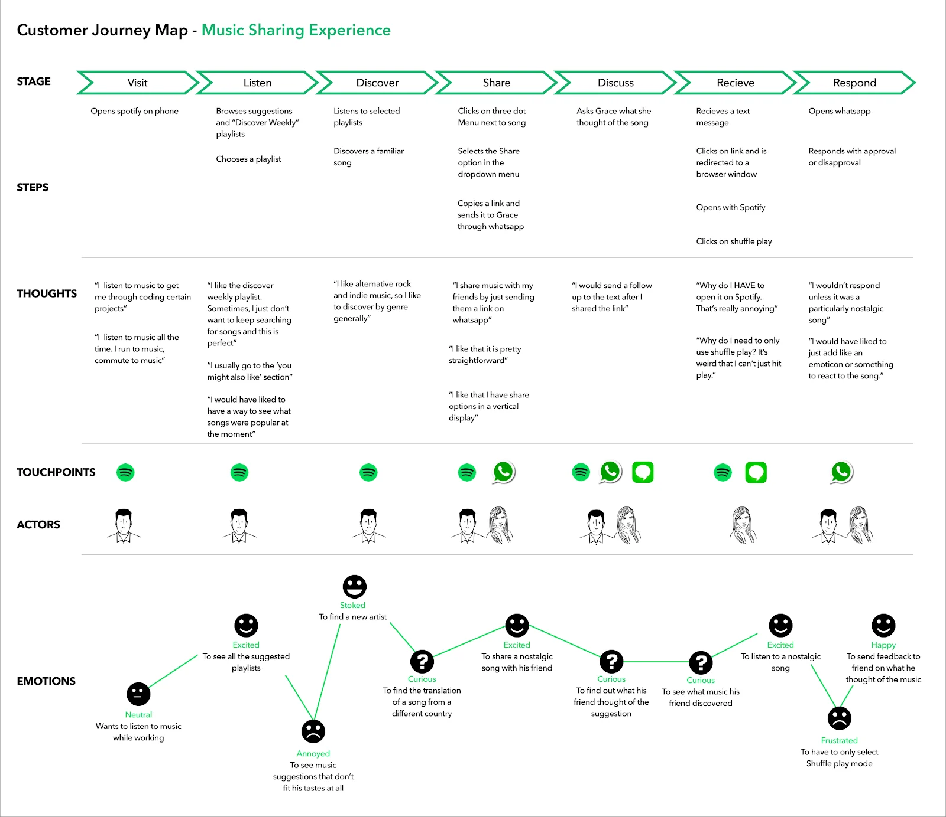
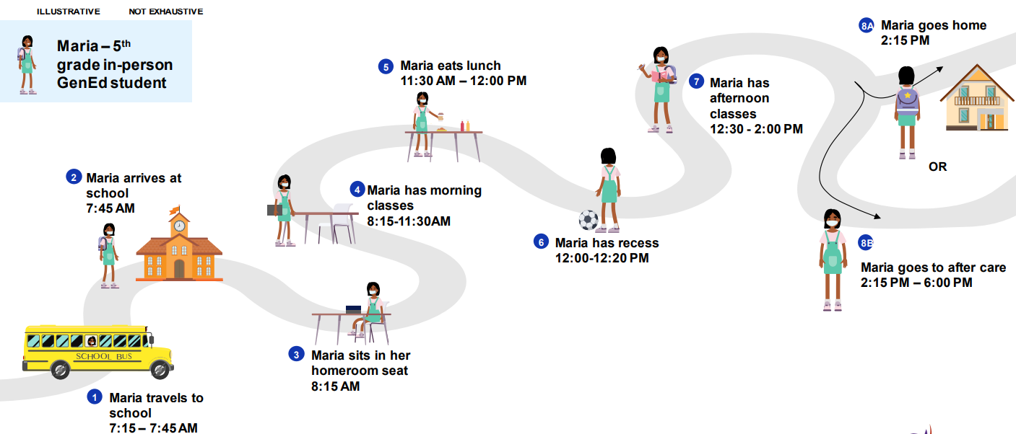
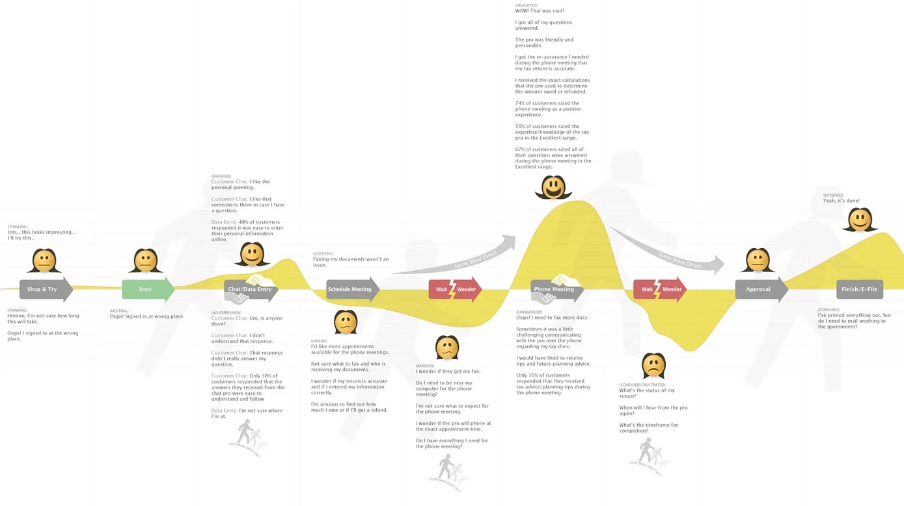
Examples of Journey Mapping

Slide 12
Let’s Practice Together!
Ask Yourself Probing Questions Like:
What is essential to making my day successful? How do I navigate the day when those essentials aren’t met?
What brings me joy / what are major stressors during my day?
What might be the same and different In my journey map versus others’ maps?
Where do I feel the most and least amount of power and control in my daily activities?
Map Major Events Like:
Getting Ready for the Day
Transportation to Work
Your Workday in a Nutshell
Transportation from Work
Extra Duties & Activities
Winding Down from the Day

Slide 13
Reflect on the Process and Prepare to ACT
What did the Journey Mapping process reveal to you? Think HEAD - HEART - HANDS
How might you do this process with a student to capture the most accurate map for them?
What parts will be most helpful to identifying leadership opportunities for your students?

Slide 14
HW: Journey Mapping Students
STEP 1:
STEP 2:
STEP 3:
Strategically choose a student (or small group of students) that could most benefit from Student Leadership opportunities.
Map their journeys by using suggested Major Events and Probing Questions from practice activity today.
Be prepared to share your Journey Mapping process with your colleagues during the next CoP session on Tuesday, March 12th.

Slide 15
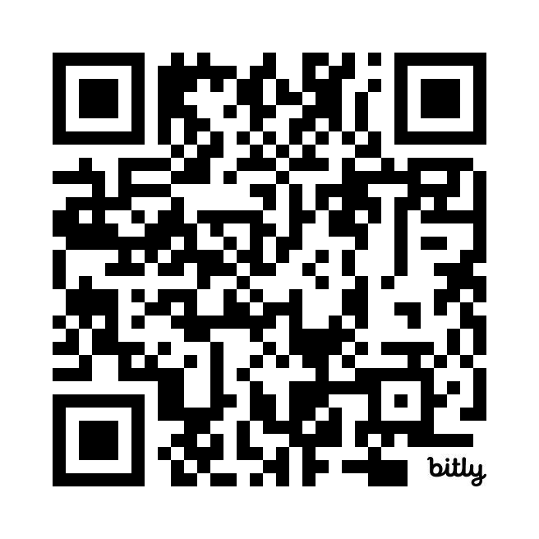
SURVEY
INSPIRATION
Your feedback is important. Please access our survey at:
bit.ly/3UhJ76U
When I dare to be powerful, to use my strength in the service of my vision, then it becomes less and less important whether I am afraid. – Audre Lorde
S
QUESTIONS: adeitraining@updconsulting.com
NEXT SESSION: March 12th
SUPPORT
Send questions & comments to adeitraining@updconsulting.com

Slide 16
Journey Mapping: A Day in the LIfe of an AE Student
Example Illustration from Chiefs for Change DILO Activity Guidebook, 2021

